Slide 1
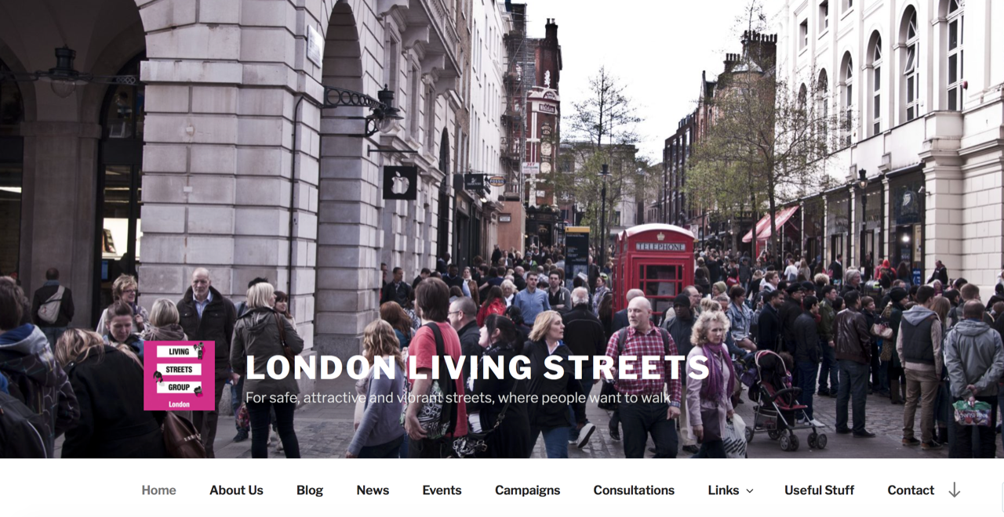
Notes:
1

Slide 2
  Campaigns, including
  Low traffic neighbourhoods
  Central London Walking Network.
  Parklets
  Electric vehicle charging points
  Timing of crossings

