Slide 1

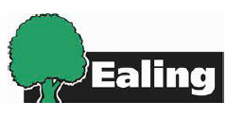
West Ealing
Liveable
Neighbourhood
(WELN)
Urban Design Group
& London Living Streets
May 23rd 2018
Tim Melhuish
Programme Manager
melhuishti@ealing.gov.uk

Slide 2

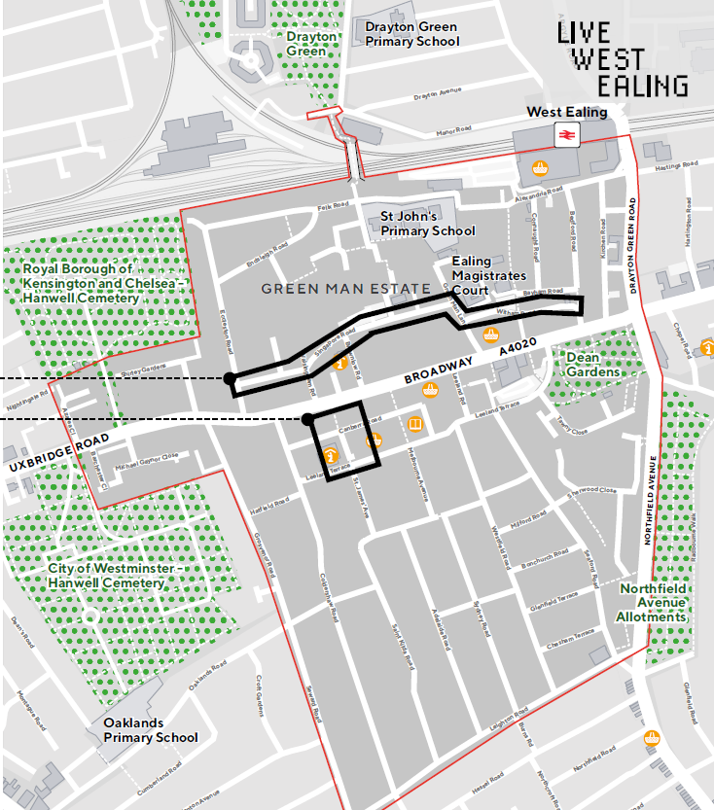
Context
Jacobs Ladder Footbridge
Lido Junction
Singapore Rd/ Witham Rd Corridor
Low Emission Bus Corridor
St James Ave
West Ealing Liveable Neighbourhood

Slide 3
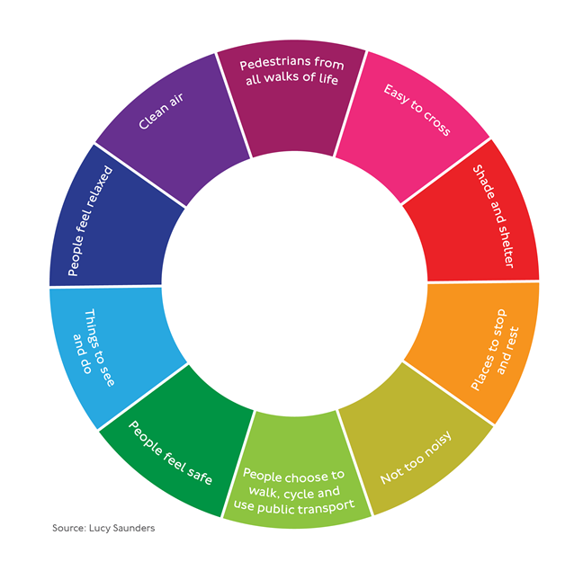
Underlying principles
£8.6m over 3 years…
West Ealing Liveable Neighbourhood

Slide 4
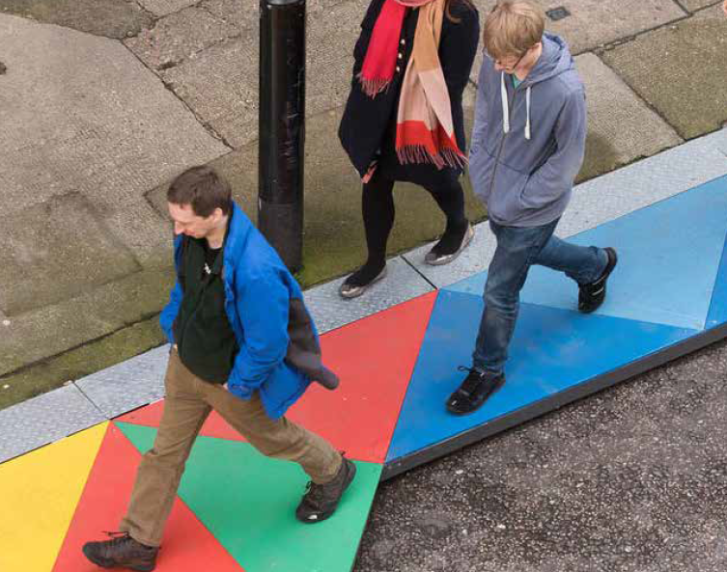
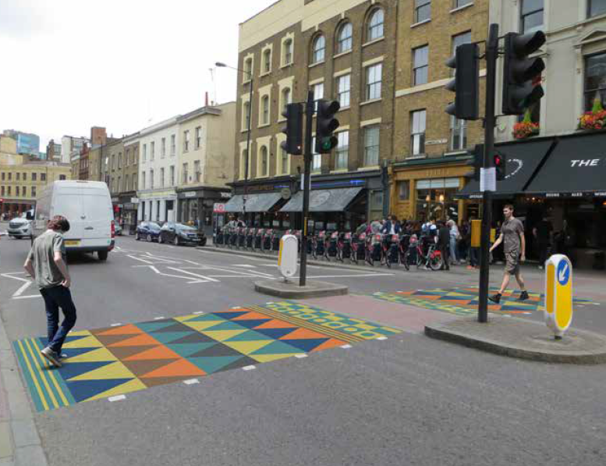
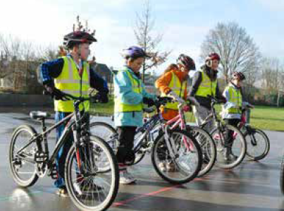
Our approach
Working with SDG to:
Collect data
Undertake surveys
Develop and identity for the place
Create a project website
Consult & engage
Test and trial ideas
West Ealing Liveable Neighbourhood

Slide 5
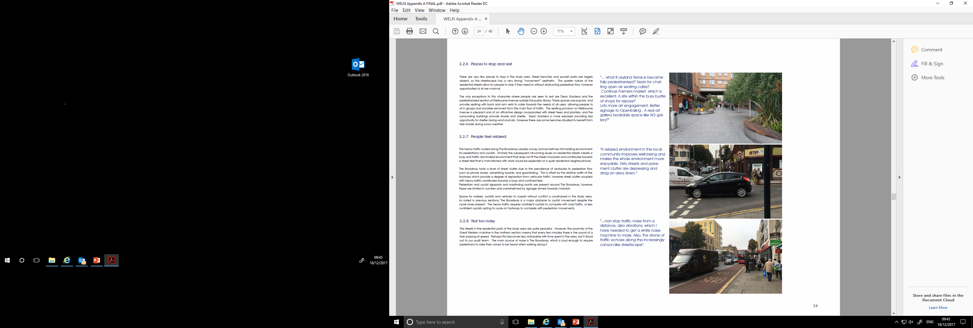
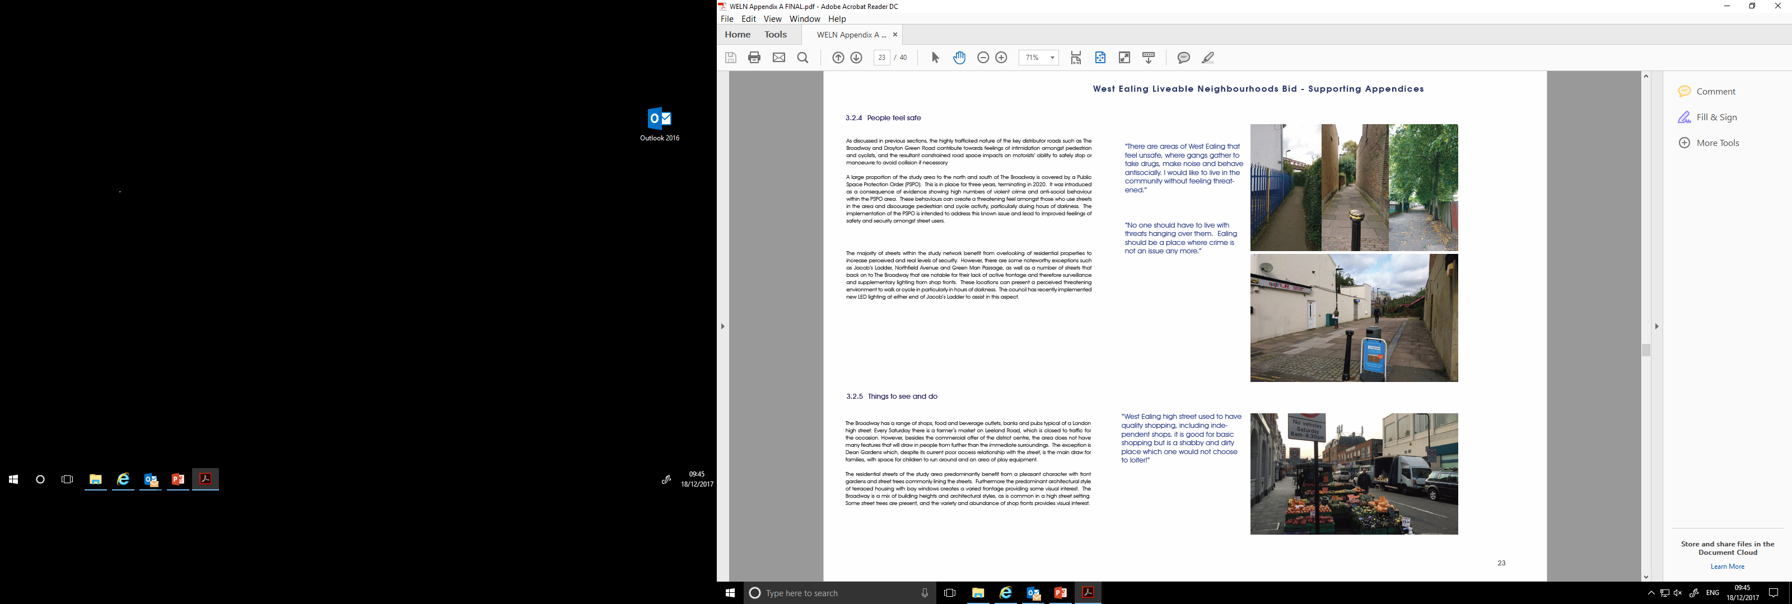
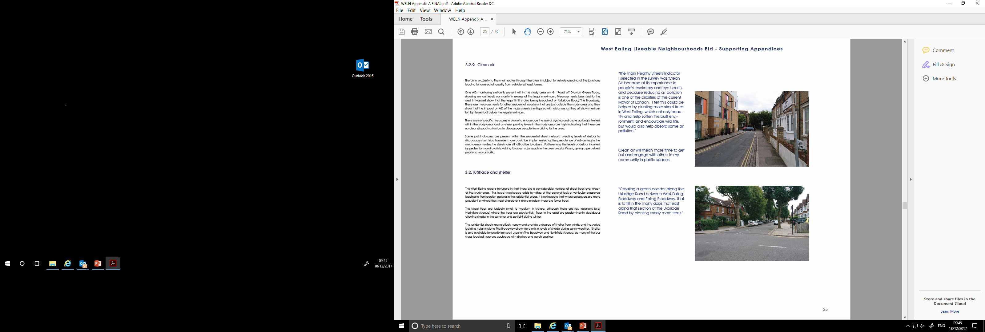
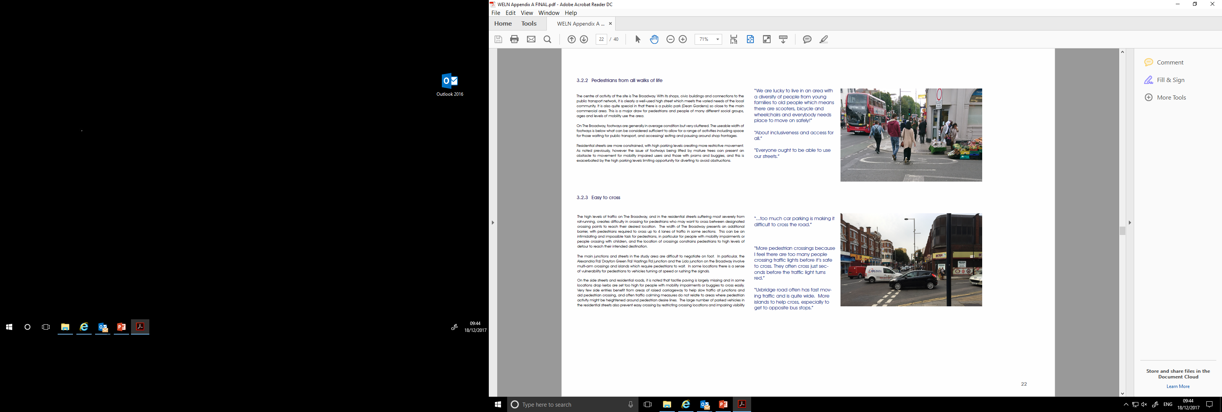
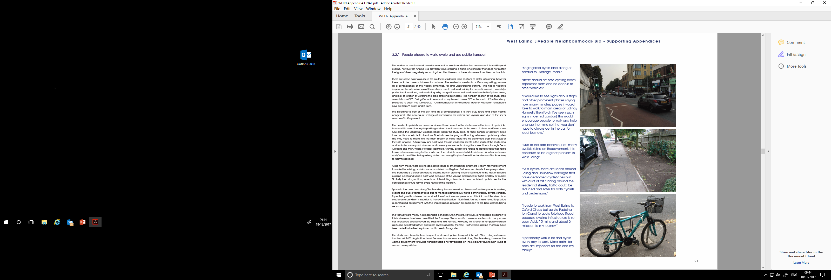
The place
There are a number
of issues…
West Ealing Liveable Neighbourhood

Slide 6
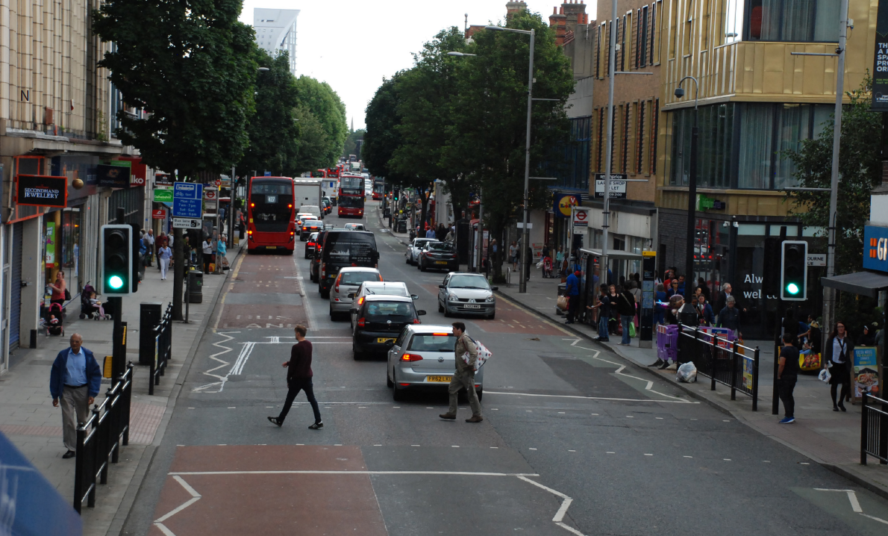
Reduce road casualties
Better accessibility
More people cycling
Clean & Safer
People choose to cycle
More attractive
Planting more trees
Better air quality
West Ealing Liveable Neighbourhood

Slide 7



Inspiration
The Broadway
  De-cluttering
  More cycle parking
  Relocate pedestrian crossings
  Resurfacing & Copenhagen Crossings
Outer Areas
  Filtered permeability & road closures
  Enhanced greenery & tree planting
  Area wide 20mph limit
  Entrance gateways
Behavioural change
  Information, Cycle Training & Personalised Travel Plans
  Play streets and street closure events
  Historic walking and adult walking promos and activities
  Public art and feature lighting
  Enjoyment and feel-good factor
  Active citizenship
West Ealing Liveable Neighbourhood

Slide 8

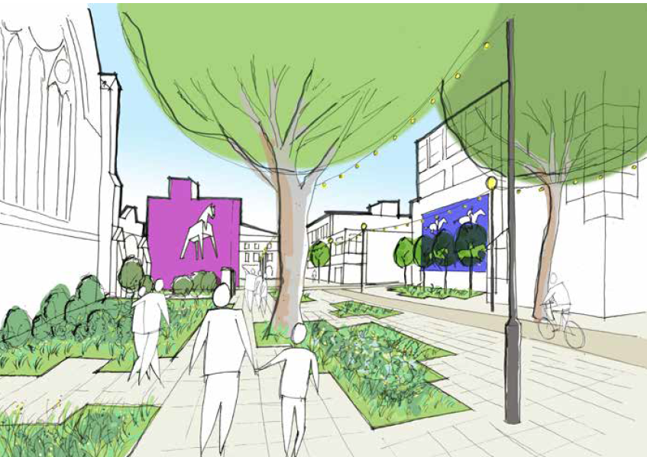
St James Avenue
West Ealing Liveable Neighbourhood

Slide 9





Collaboration
Local community
Stakeholder groups
Politicians
LB Ealing officers
TfL officers
West Ealing Liveable Neighbourhood

Slide 10
Thanks and any questions?
West Ealing Liveable Neighbourhood

