Slide 1
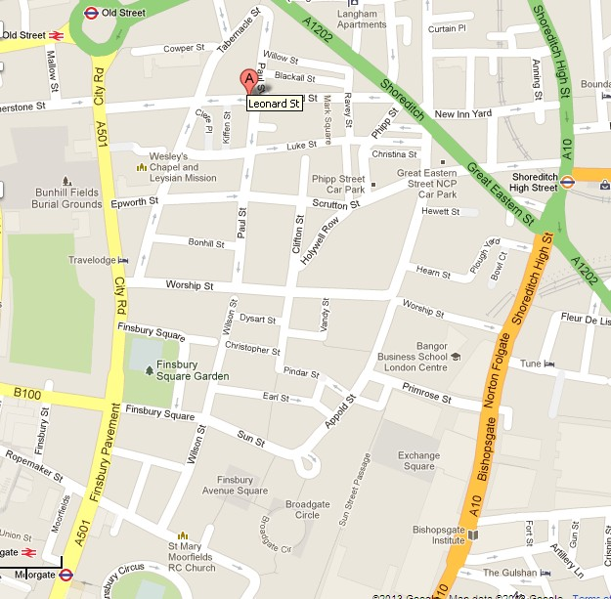
Leonard Circus - Location
Leonard Street
Paul Street
Shoreditch EC2
Haggerston Ward
City of London
LB Islington
Business Area
One Way system

Slide 2
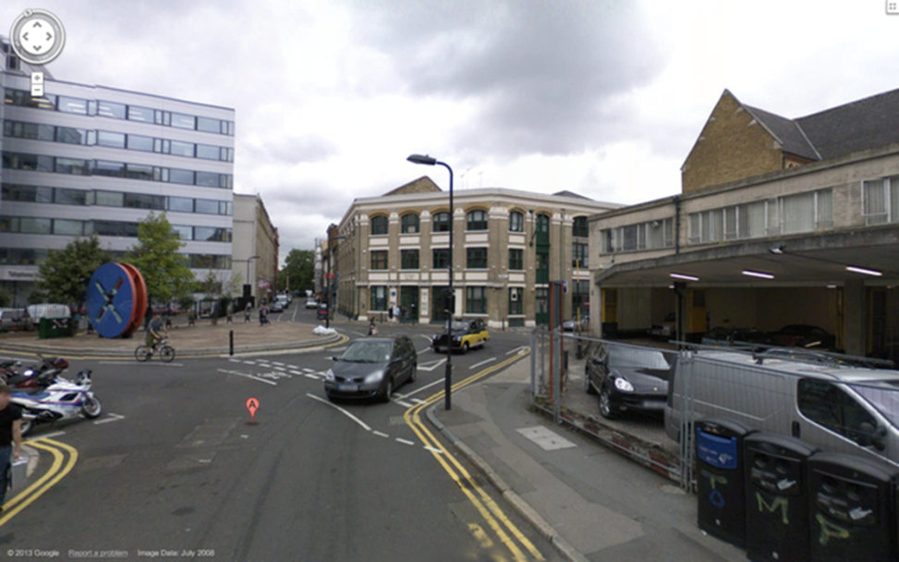
Leonard Circus - Location
Councils Transport Vision
Hackneys Transport Strategy
Create a range of environments that will encourage walking & cycling within & through the borough

Slide 3
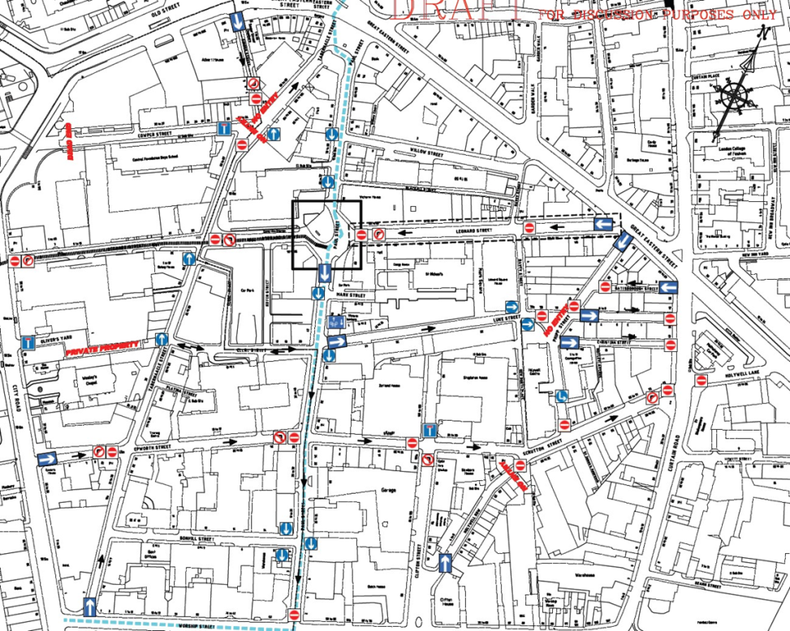
Leonard Circus - Location
Why Leonard Circus?
Suitable location
Congestion charge zone
CPZ
20mph Zone
One-way system discourages through traffic
LCN Route & CS1

Slide 4
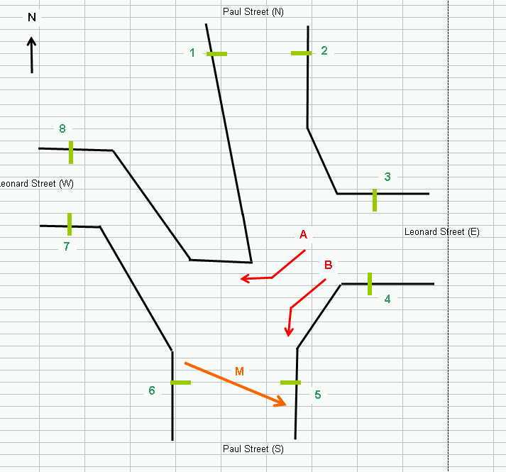
Leonard Circus – Traffic Surveys
Pedestrian Count 13/12/11 – 13,492
Daily Vehicle Totals A & B (inc Cycles) – 4767
Of this 2308 were cyclists!
M = southbound peds favoured crossing point

Slide 5
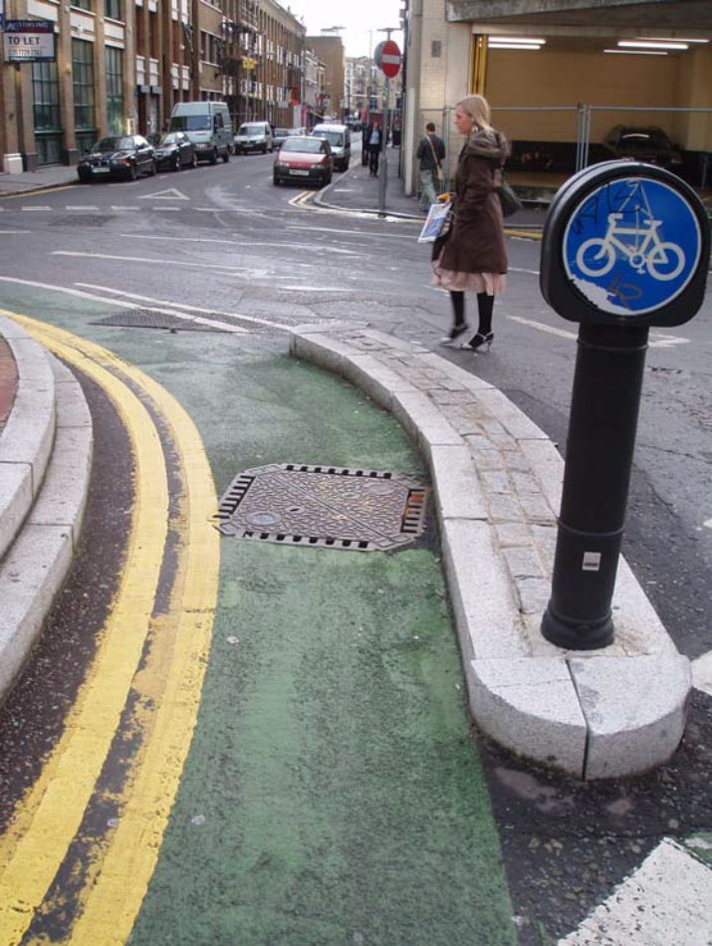
6 - Leonard Circus - Before
Over engineered traffic layout
Raised traffic island created a distinct barrier to pedestrian movement
Poor public amenity
Poor pedestrian accessibility
High Ped (13492) & Cycle movement (2308)
Zero accident record!

Slide 6
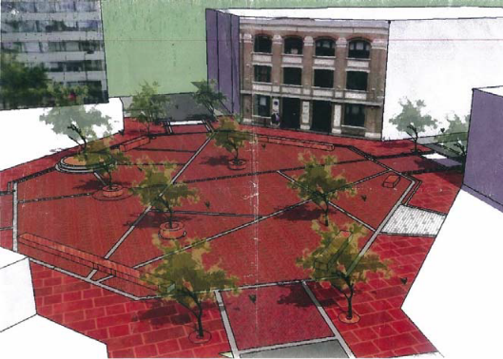
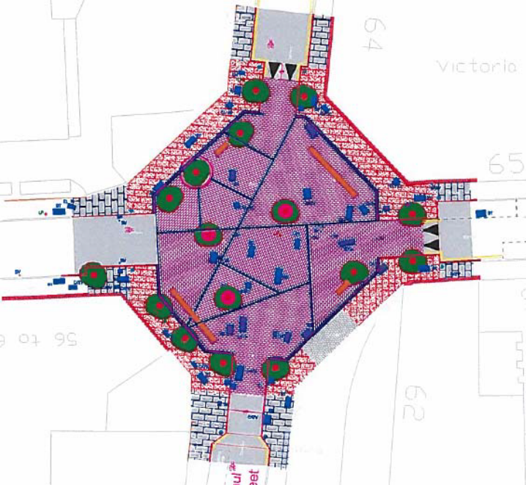
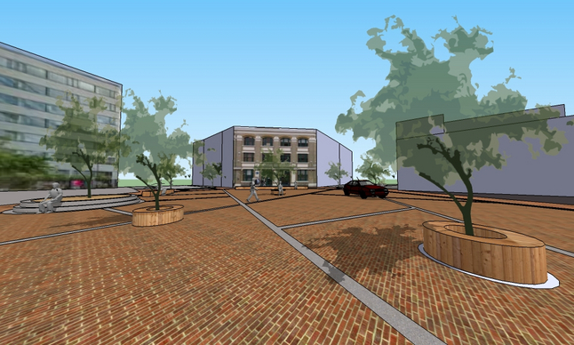
Leonard Circus – Concept

Slide 7
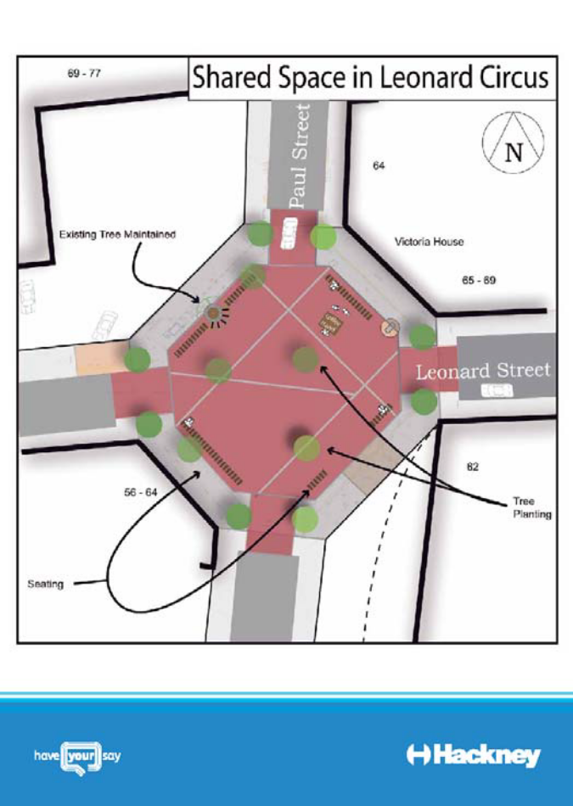
Leonard Circus - Consultation
Local Residents & Businesses
Living Streets in Hackney
London Cycling Campaign
Age Concern
Hackney Disability Back Up Group
Emergency Services
Transport for London
Urban Design London
Time to Redesign!

Slide 8
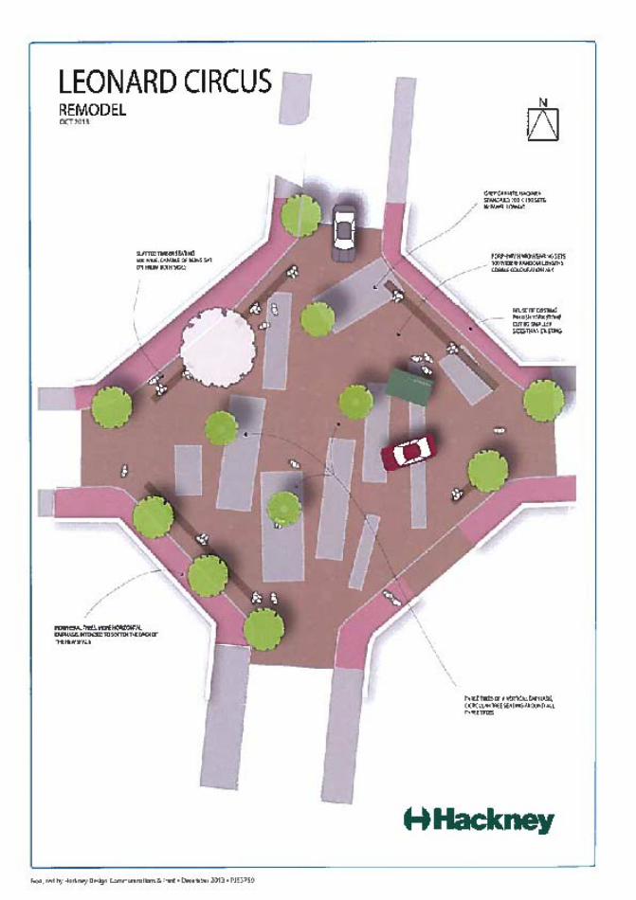
Leonard Circus – Detailed Design
Stats Issues
Foundation Issues
Building Access Issues
Existing raised tree
Material concerns
Maintenance concerns
Rivington Street-Porphry
Rethink
Redesign
Simplify

Slide 9
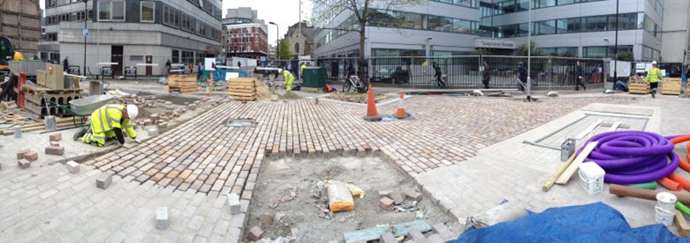
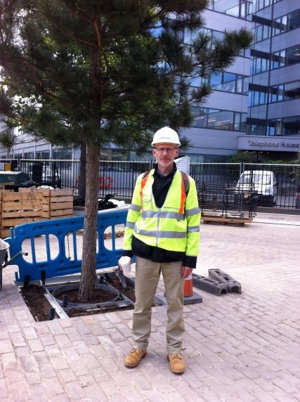
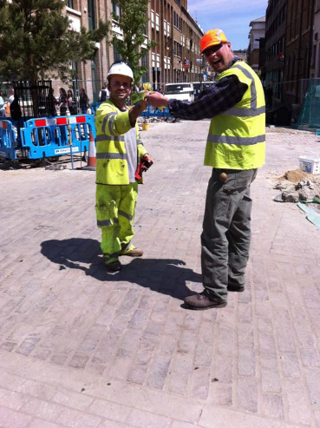
Leonard Circus – Implementation
Started 27/01/14
Complete 09/06/14
Junction closure
Diversion Route
Parking suspensions
Regular stakeholder liaison
Information boards
No problems (apart from being verbally abused by businesses)

Slide 10
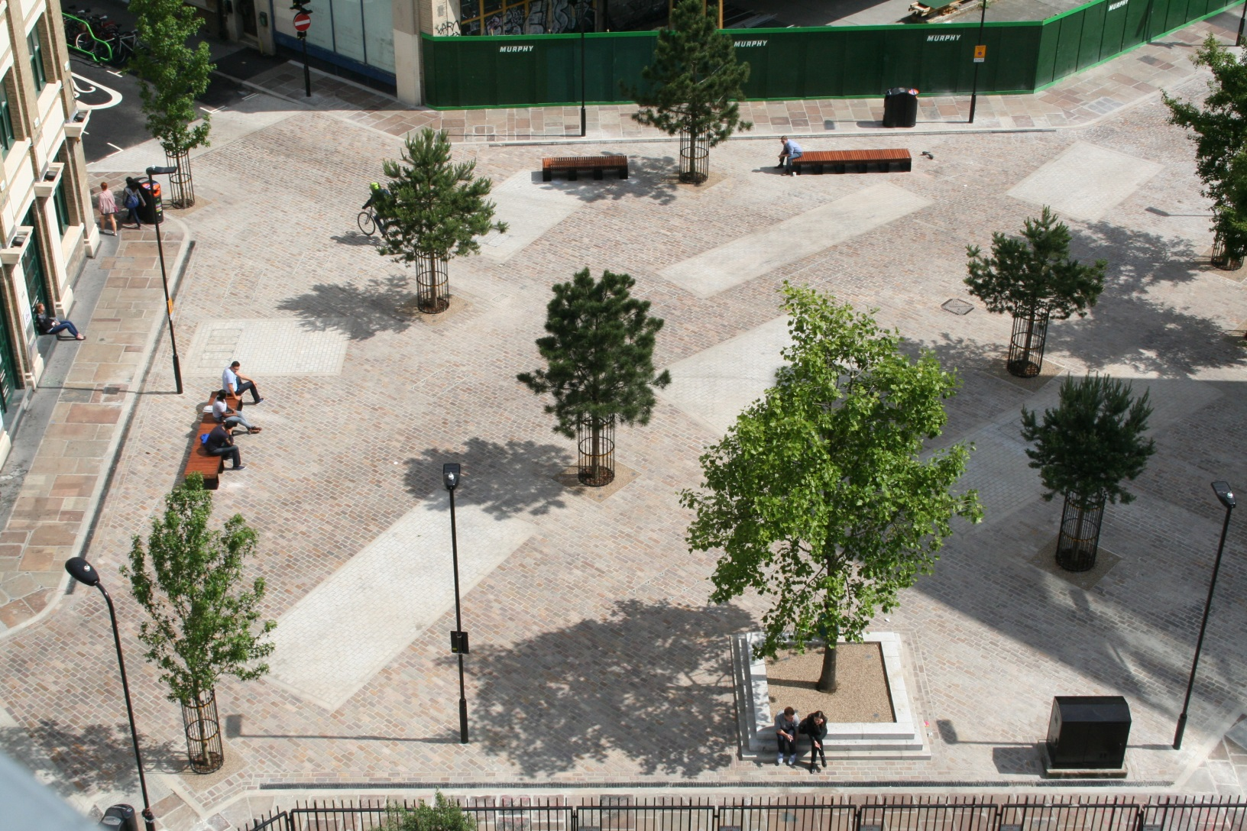
Leonard Circus – Post implementation

Slide 11
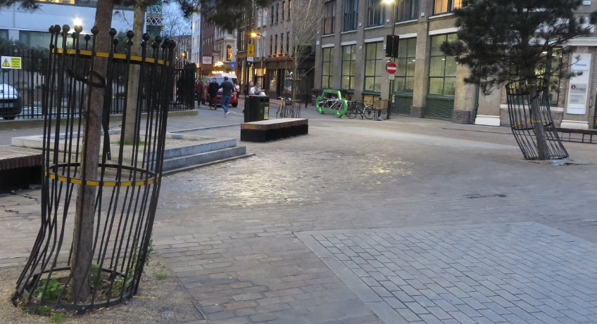
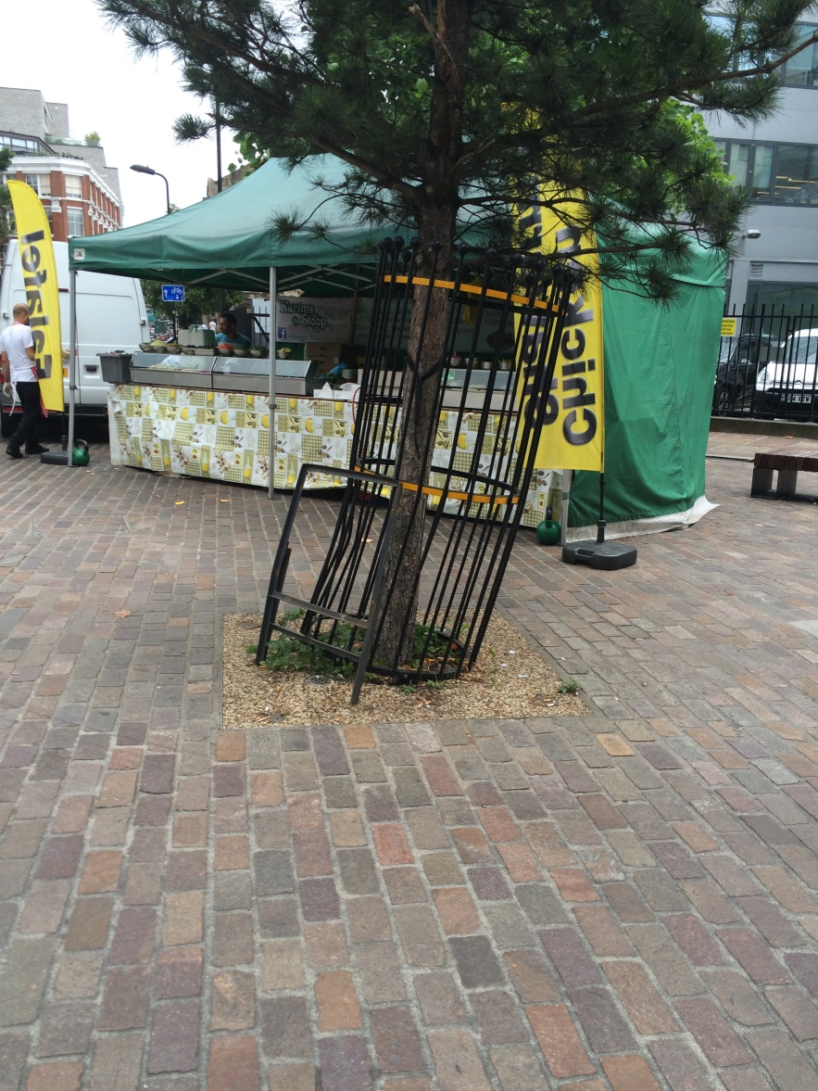
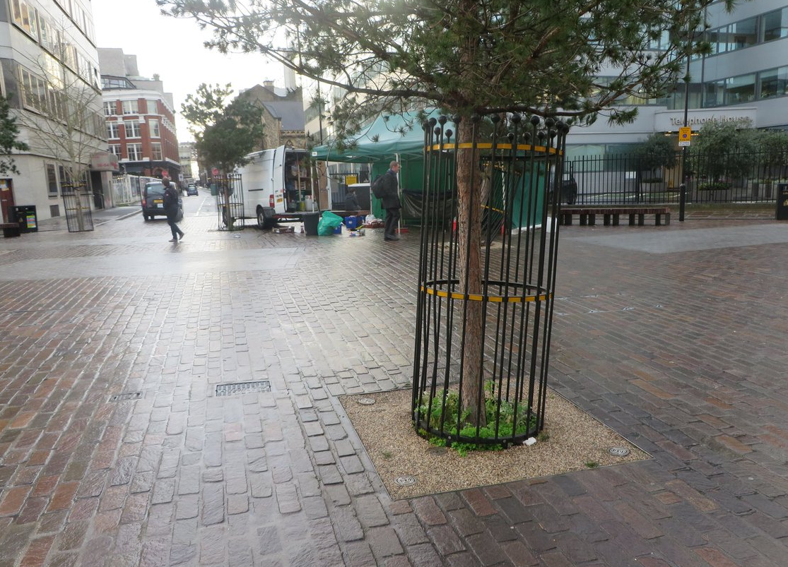
Leonard Circus – Post Implementation Issues

Slide 12
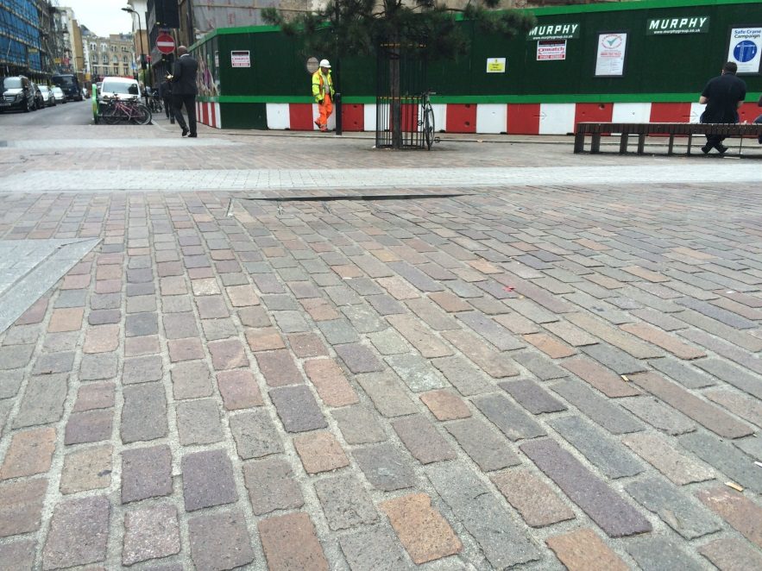
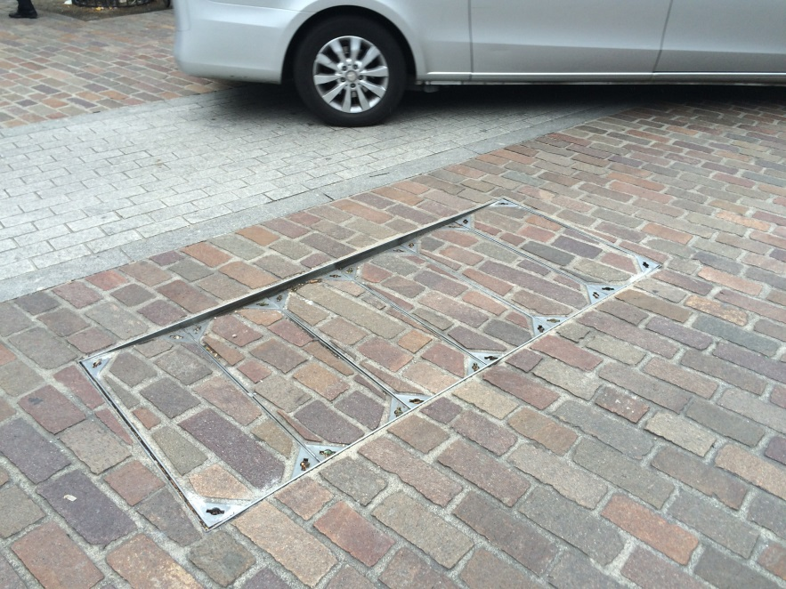
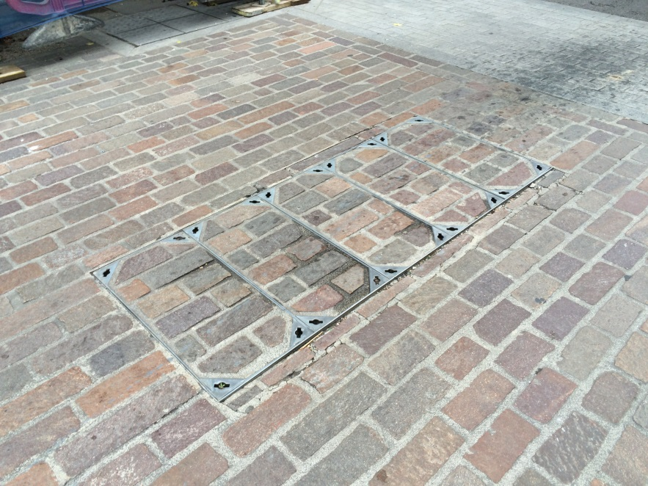
Leonard Circus – Post Implementation Issues

Slide 13
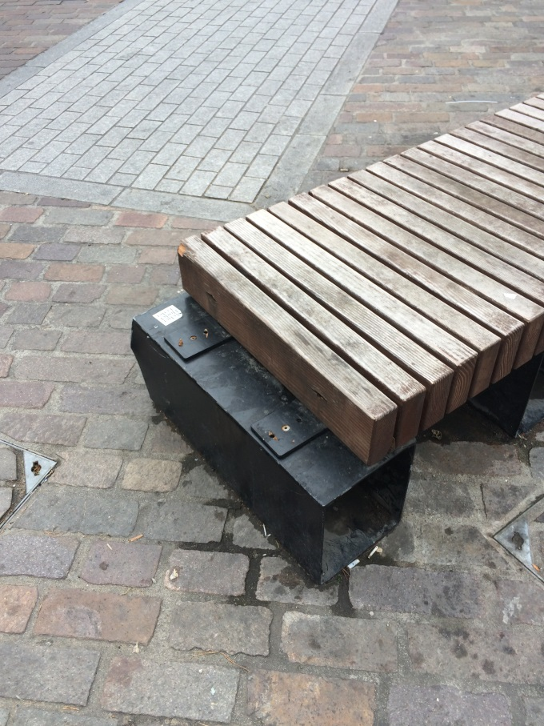
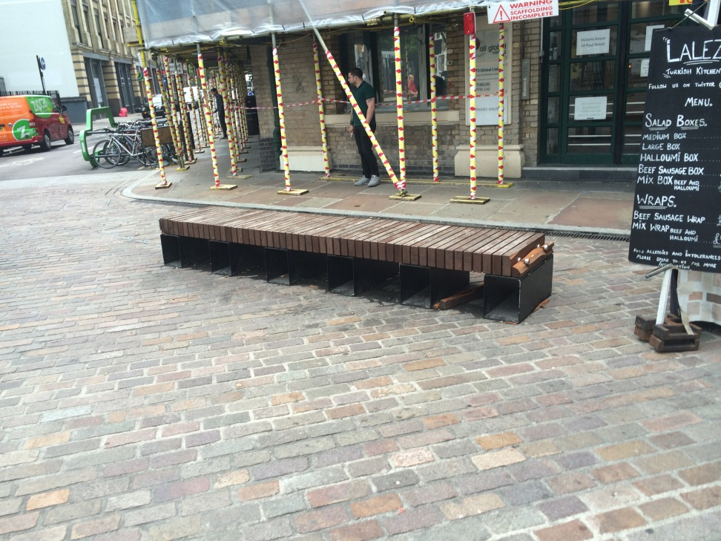
Leonard Circus – Post Implementation Issues

Slide 14

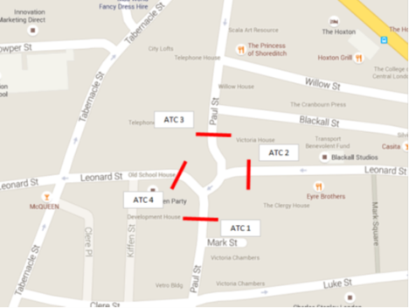
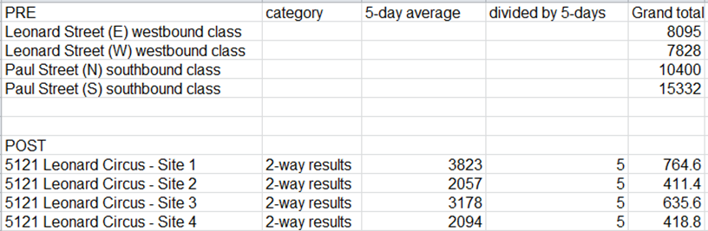
Leonard Circus – Post Traffic & Attitudinal Survey
85th percentile under 20mph
1 pedestrian & cycle collision soon after
84% of peds & 71% of cyclists said they felt safe
75% of drivers felt free to move across the space
60% of drivers felt there was adequate signage for the space
71% of all respondents felt the space is attaractive to look at and that the space is part of the neighborhood identity

Slide 15
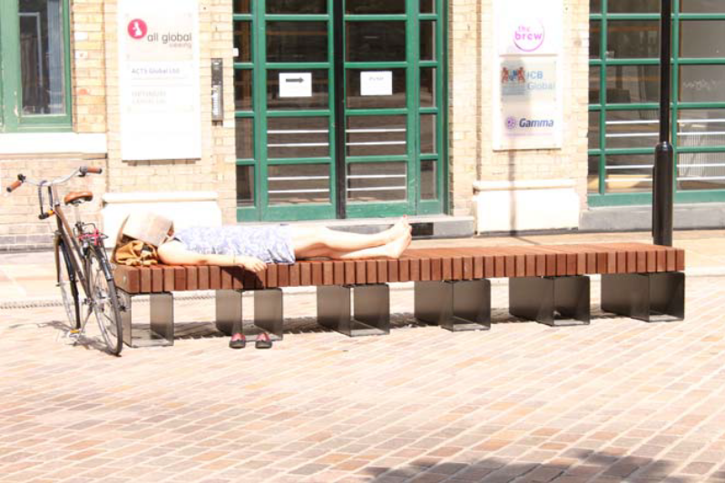
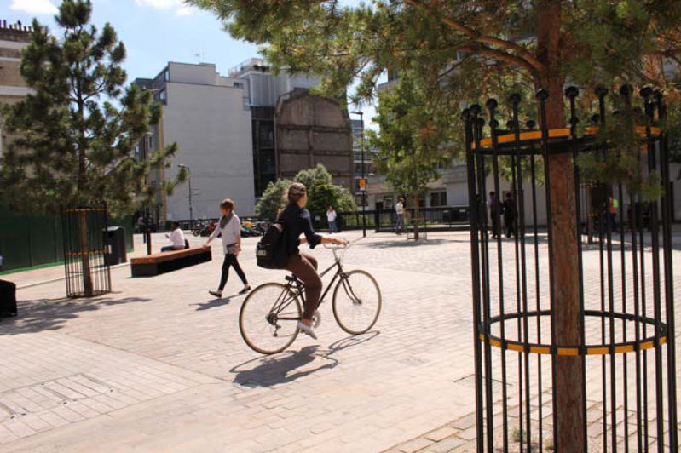
Leonard Circus – Improvements
Re-used Yorkstone
Porphry Paving
LED Street Lighting
Tree Planting (SuDS)
Modern Seating
Bike Ports
CCTV
Wi-Fi

Slide 16
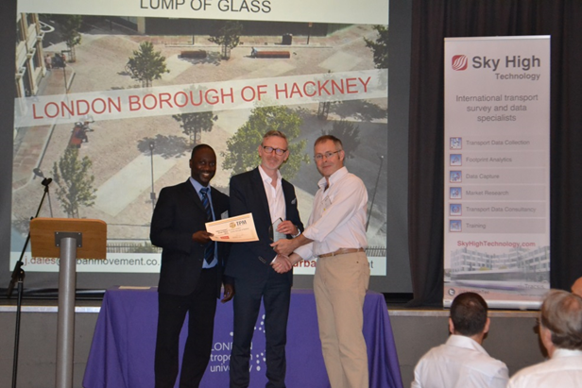
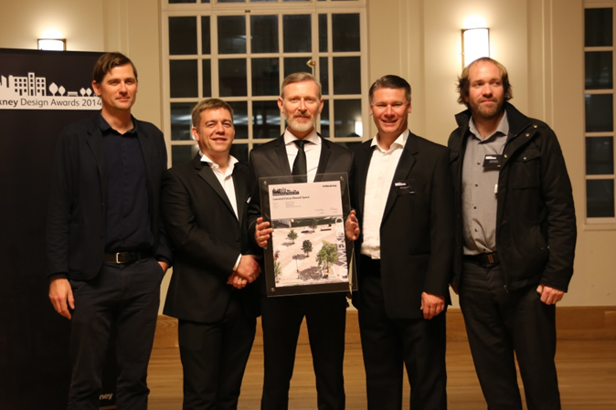
Leonard Circus – Success!
Won the Urban Transport Design Award 2015
Nominated London Cycling Awards 2015
Nominated Hackney Design Awards 2015
New vibrant public space
Generated new activities
Regeneration
Food stalls

