Slide 1
ReCharge Parklets
Susan Claris
London Living Streets
Electric Vehicles – Infrastructure and Impact
11 October 2018

Slide 2
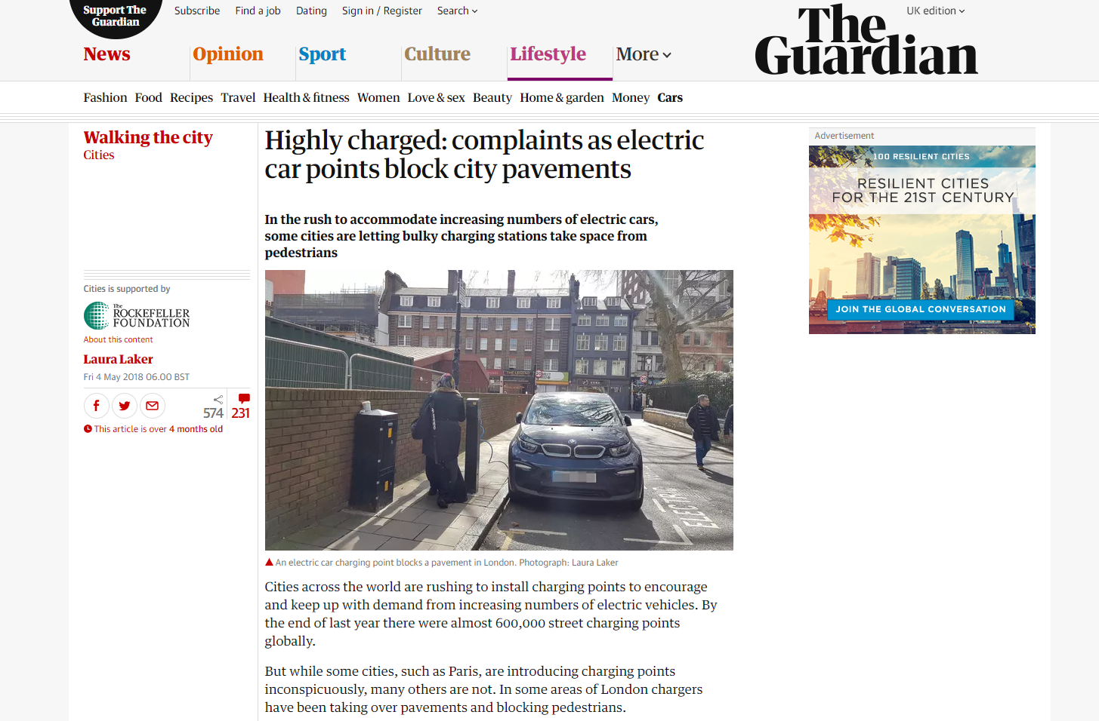
The Guardian 4 May 2018

Slide 3
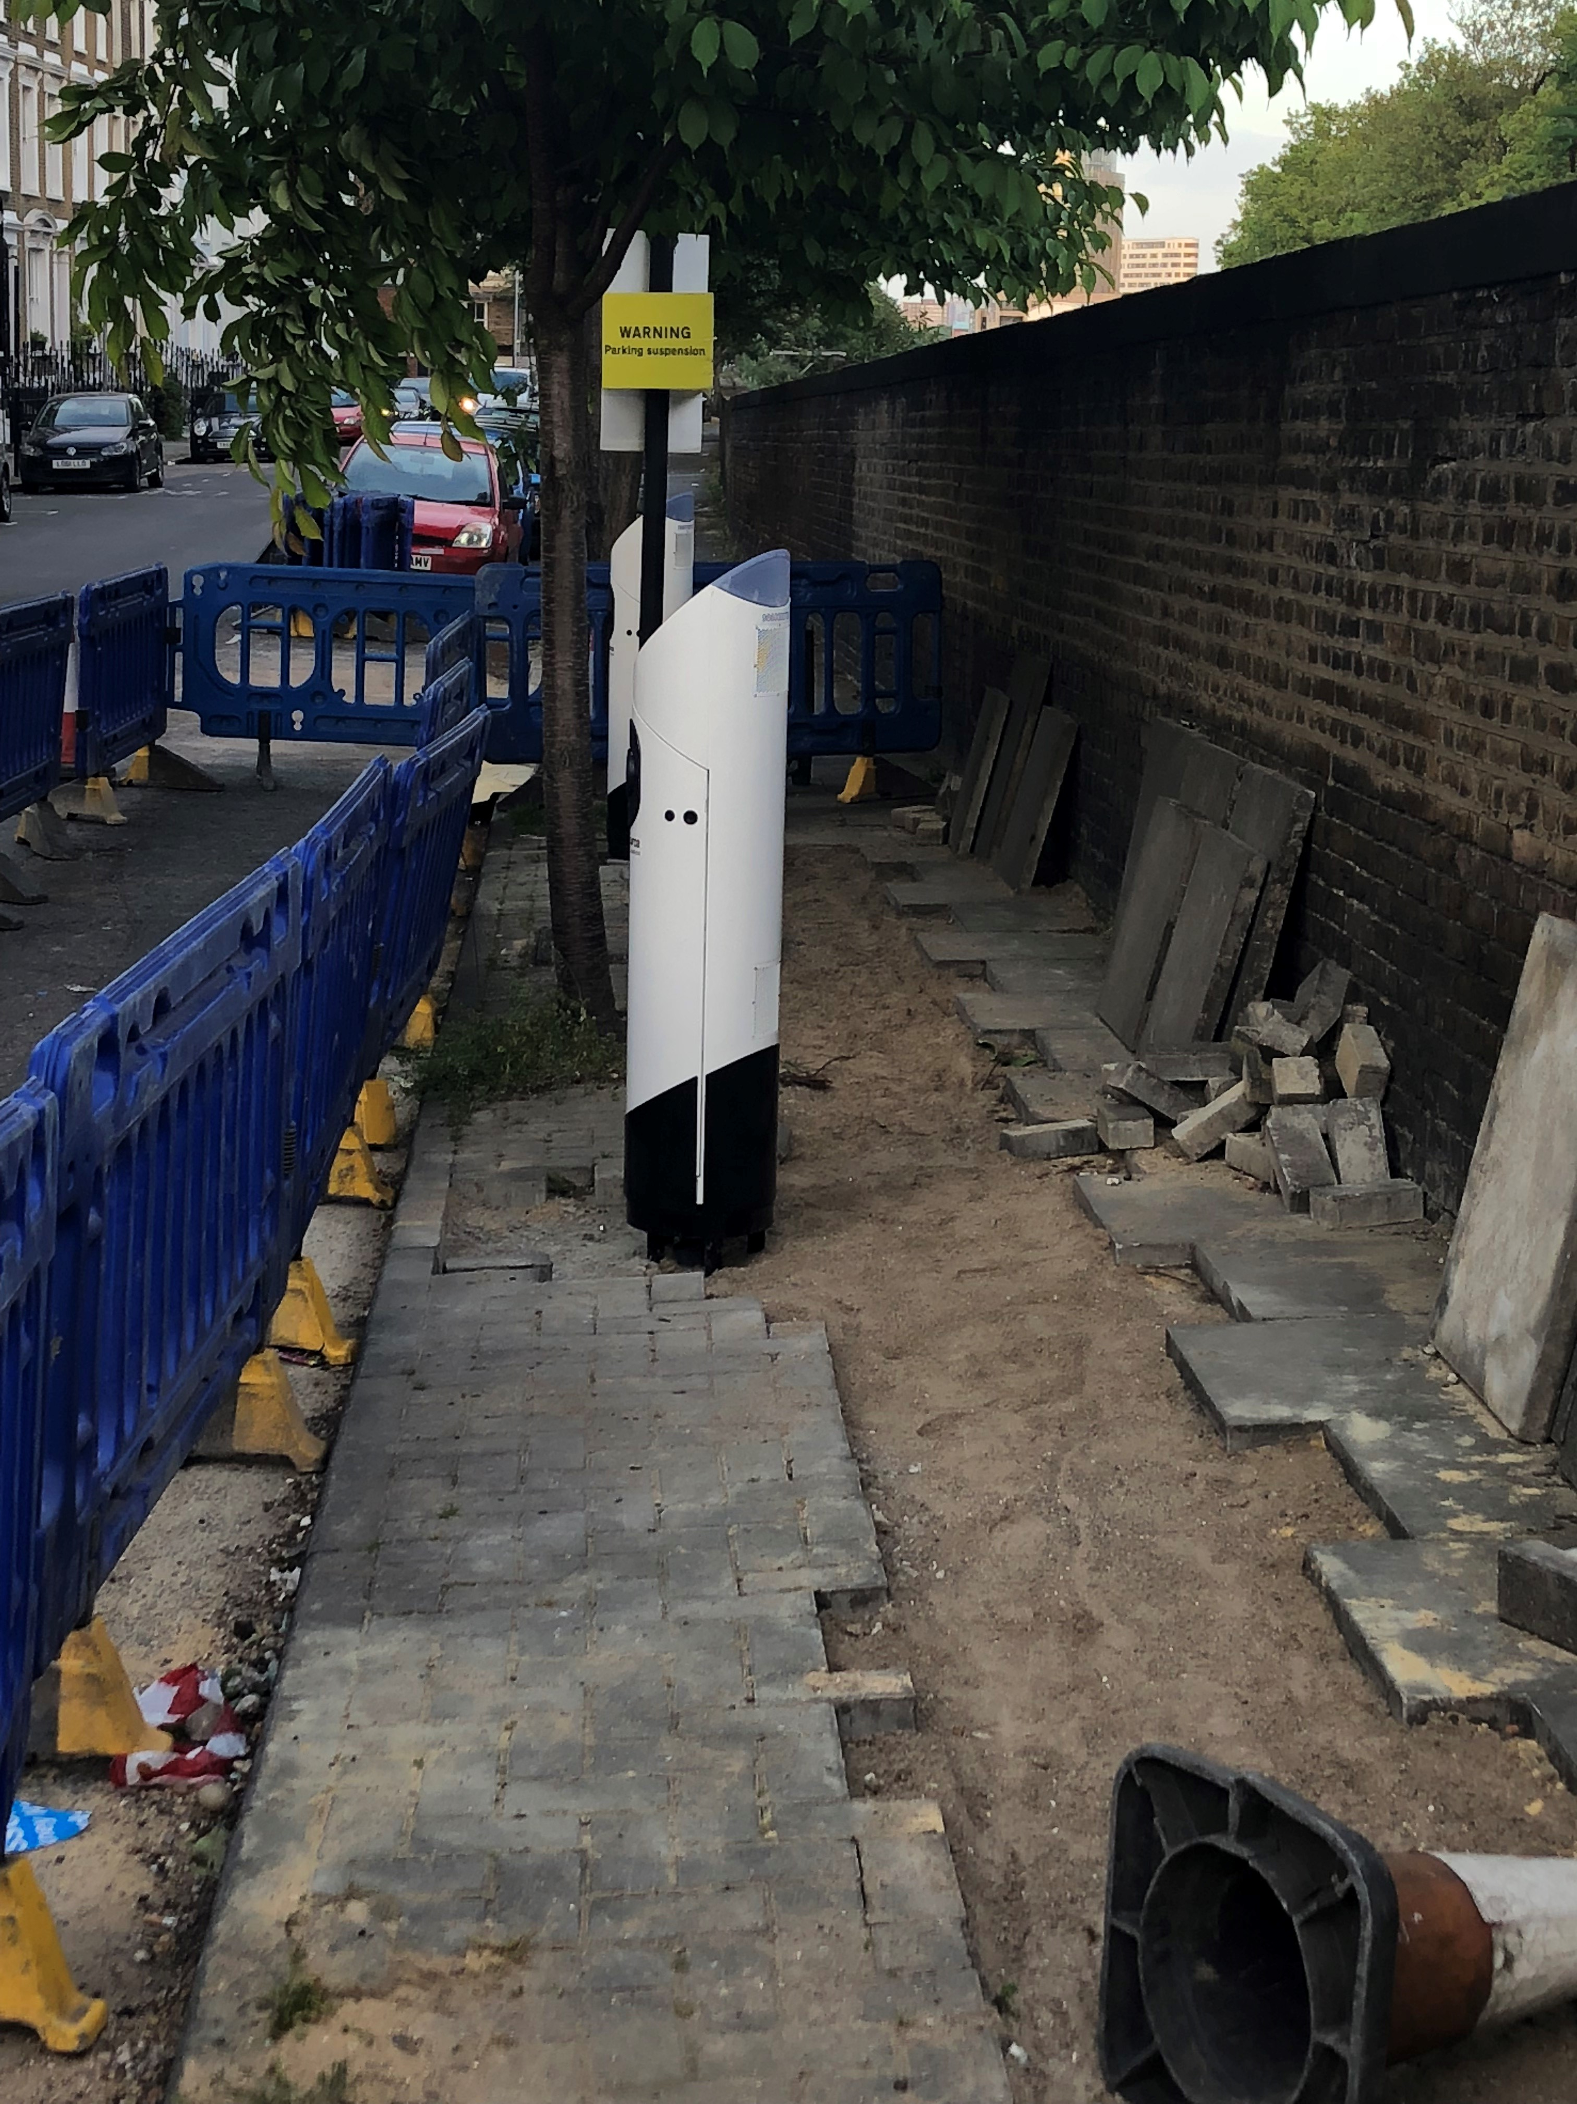
And then it got personal 17 May 2018
Notes:
17 May 2018, Mildmay Grove North

Slide 4
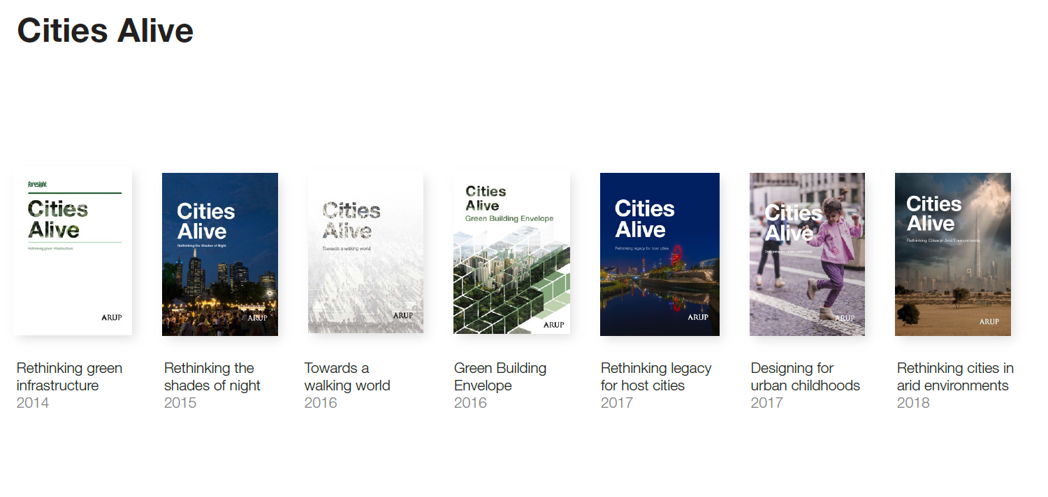
Cities Alive slide

Slide 5
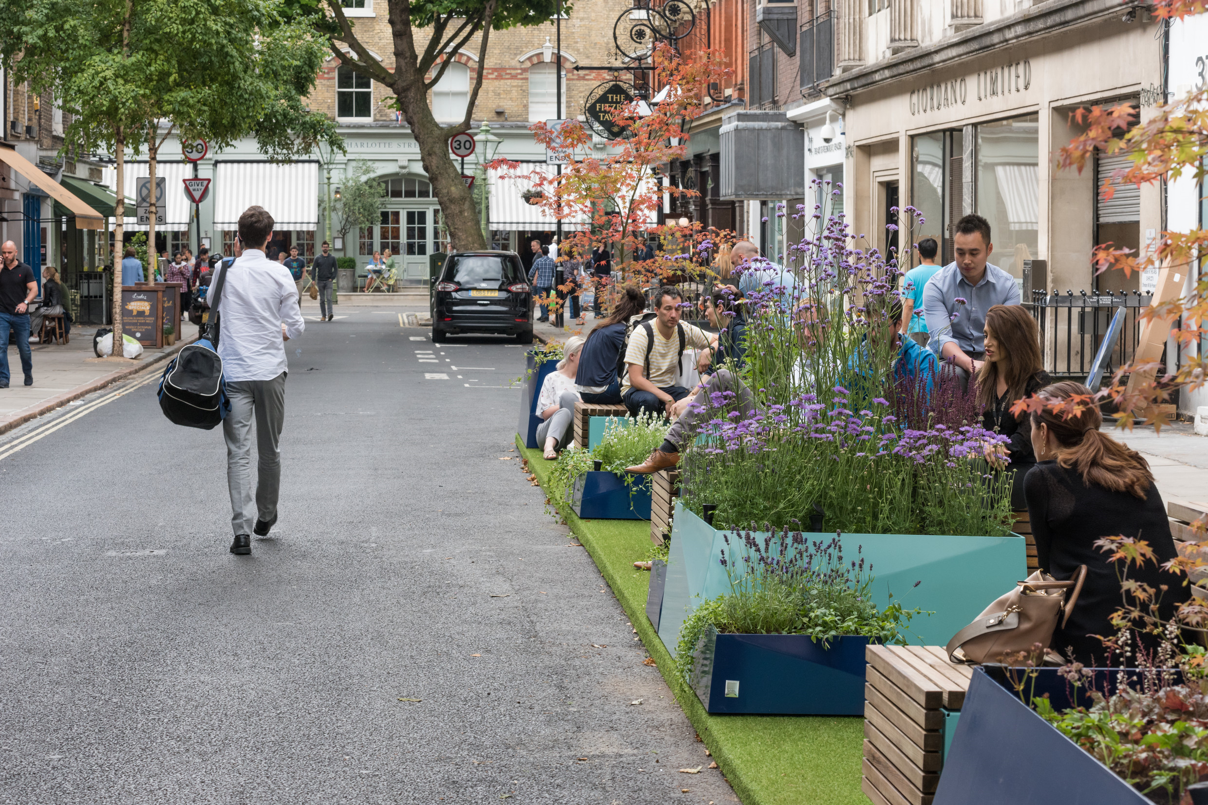
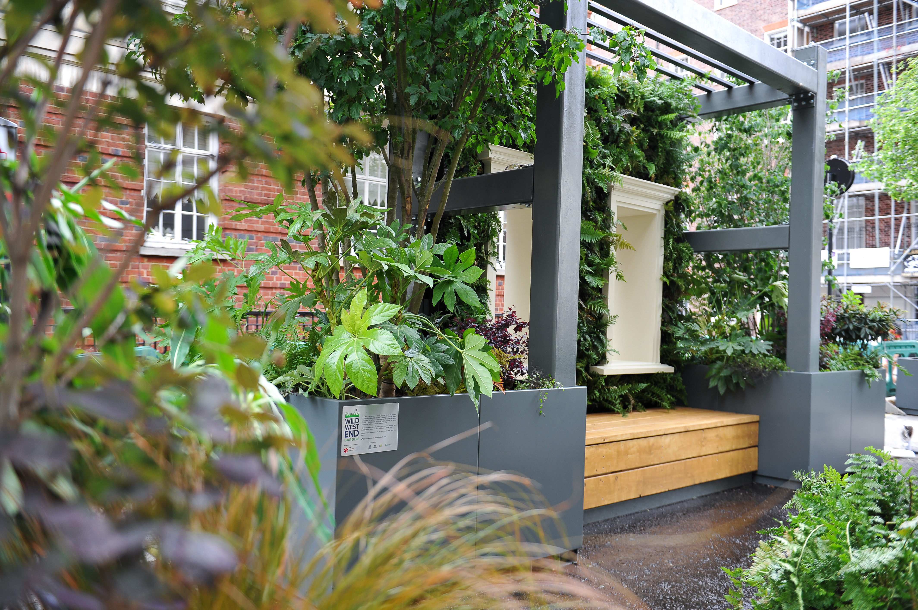
Parklets
Notes:
FitzPark, Windmill Street – Summer 2017 to Autumn 2018
Wild West End Garden, Old Quebec Street (by New West End Company and The Portman Estate in collaboration with Wild West End, Marble Arch BID and Baker Street Quarter BID).

Slide 6
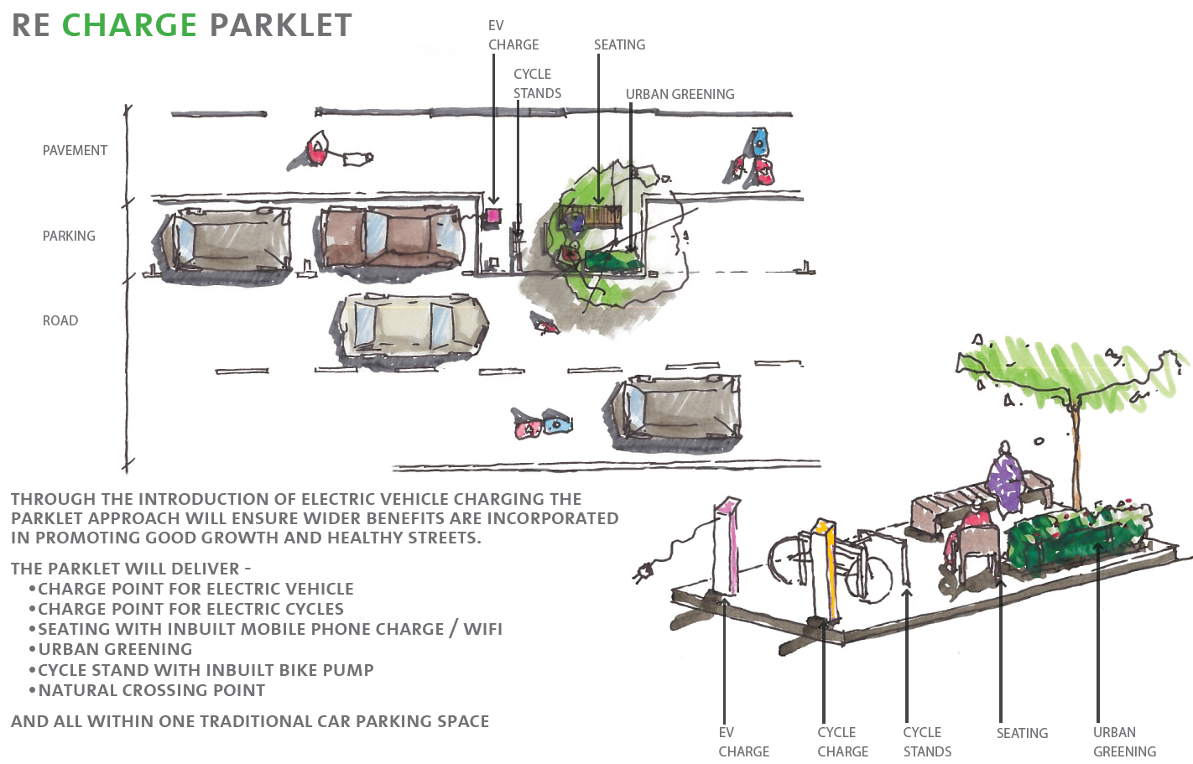
ReCharge Parklet late May/early June 2018
Notes:
Out to Twitter and LinkedIn May 2018

Slide 7
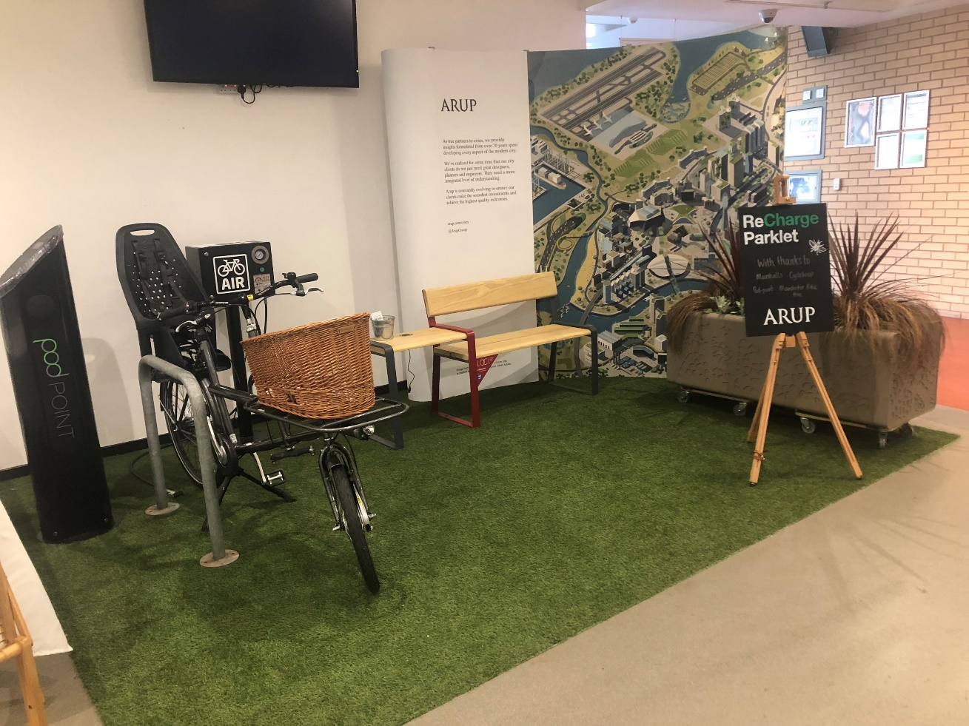
Cycle City, Active City Manchester, 28/29 June 2018

Slide 8
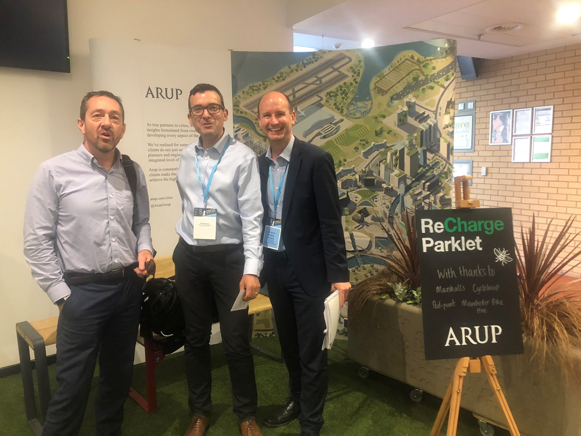
Cycle City, Active City Manchester, 28/29 June 2018

Slide 9
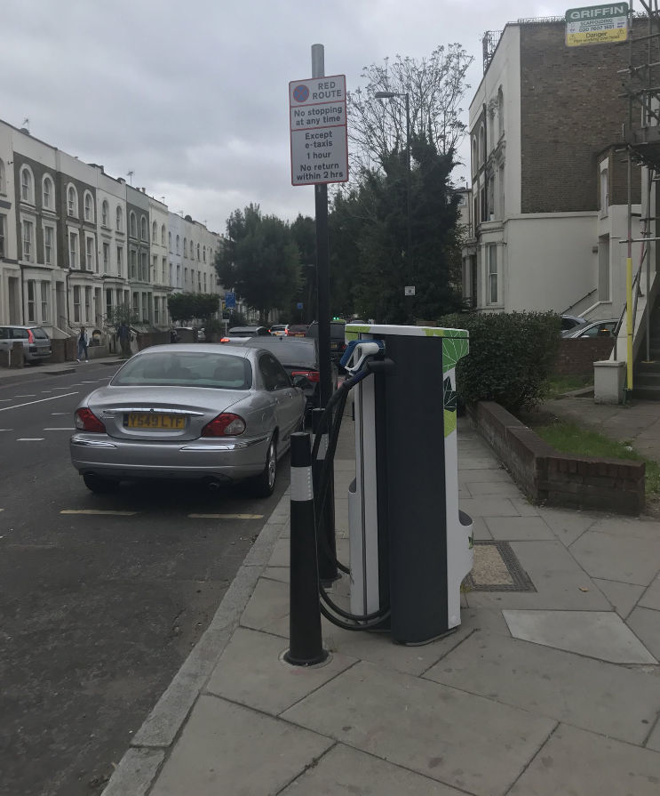
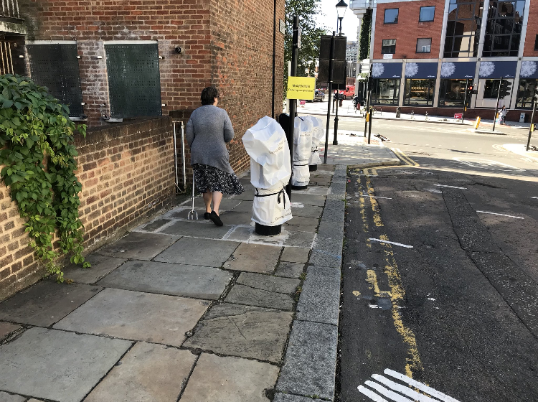
Meanwhile….. September 2018
@mum_on_bike 11/9/18
@johnstreetdales 24/9/18

Slide 10
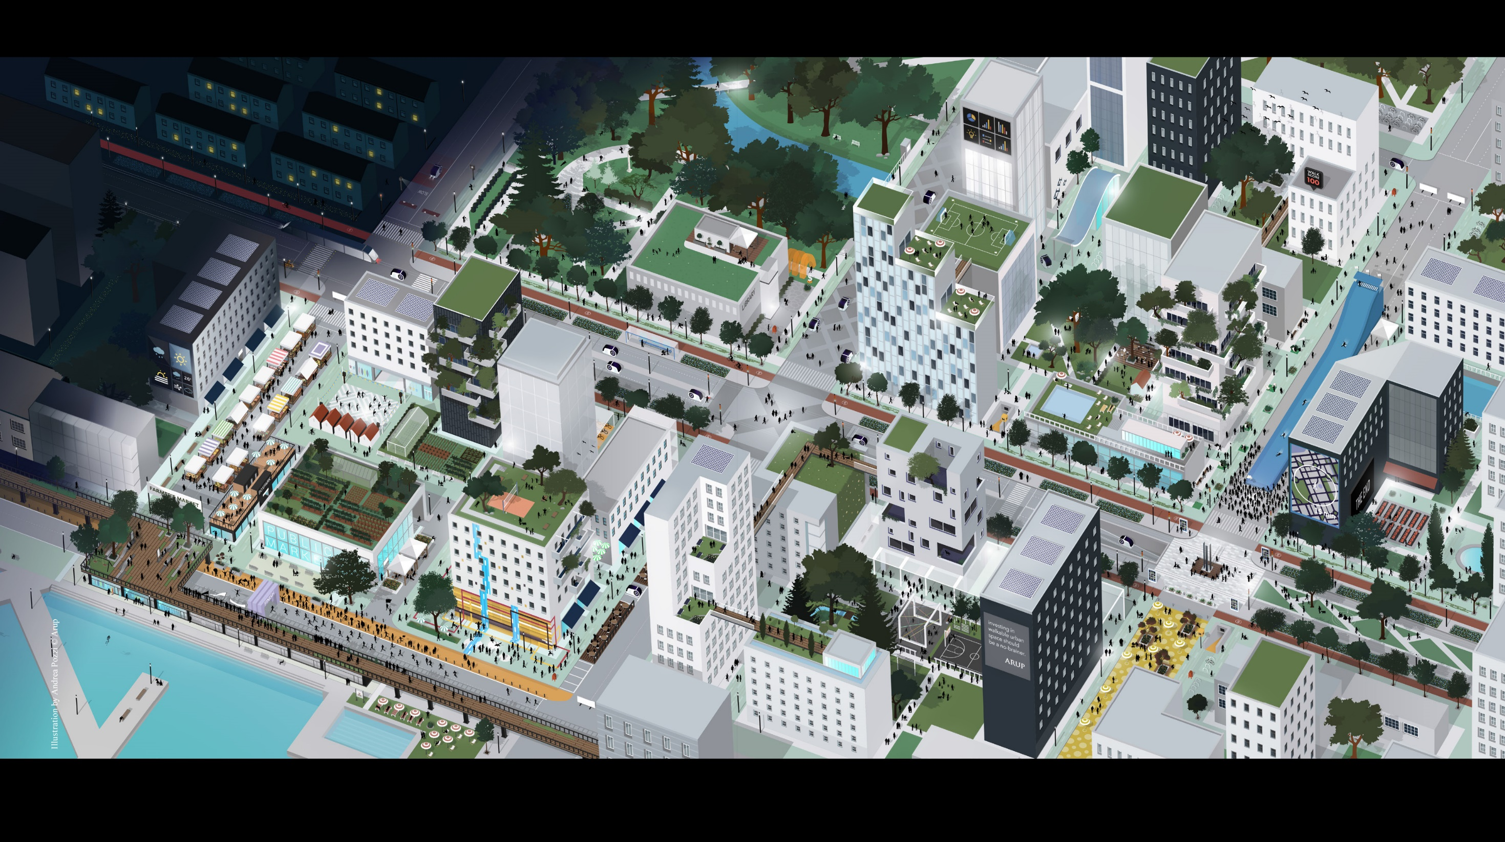


www.arup.com/walkingcities
susan.claris@arup.com
@susanclaris

