Slide 1

InclusivEV; new market for electric car sharing
Charlotte Thiery Weetman
Programme Manager Electric Mobility
Charlotte.Thiery-weetman@cenex.co.uk

Slide 2
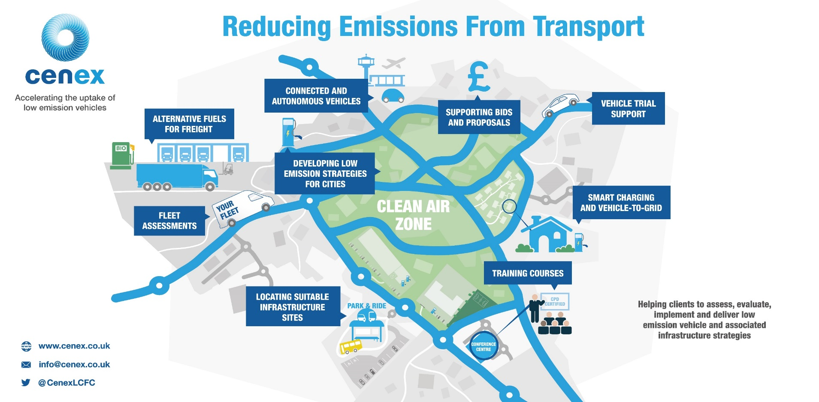
Text here
Leading independent not for profit experts, since 2005

Slide 3
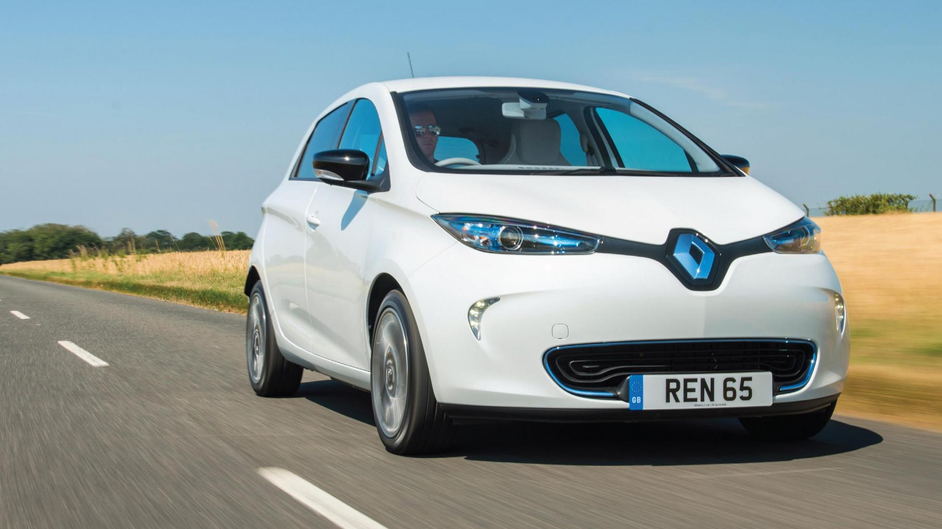
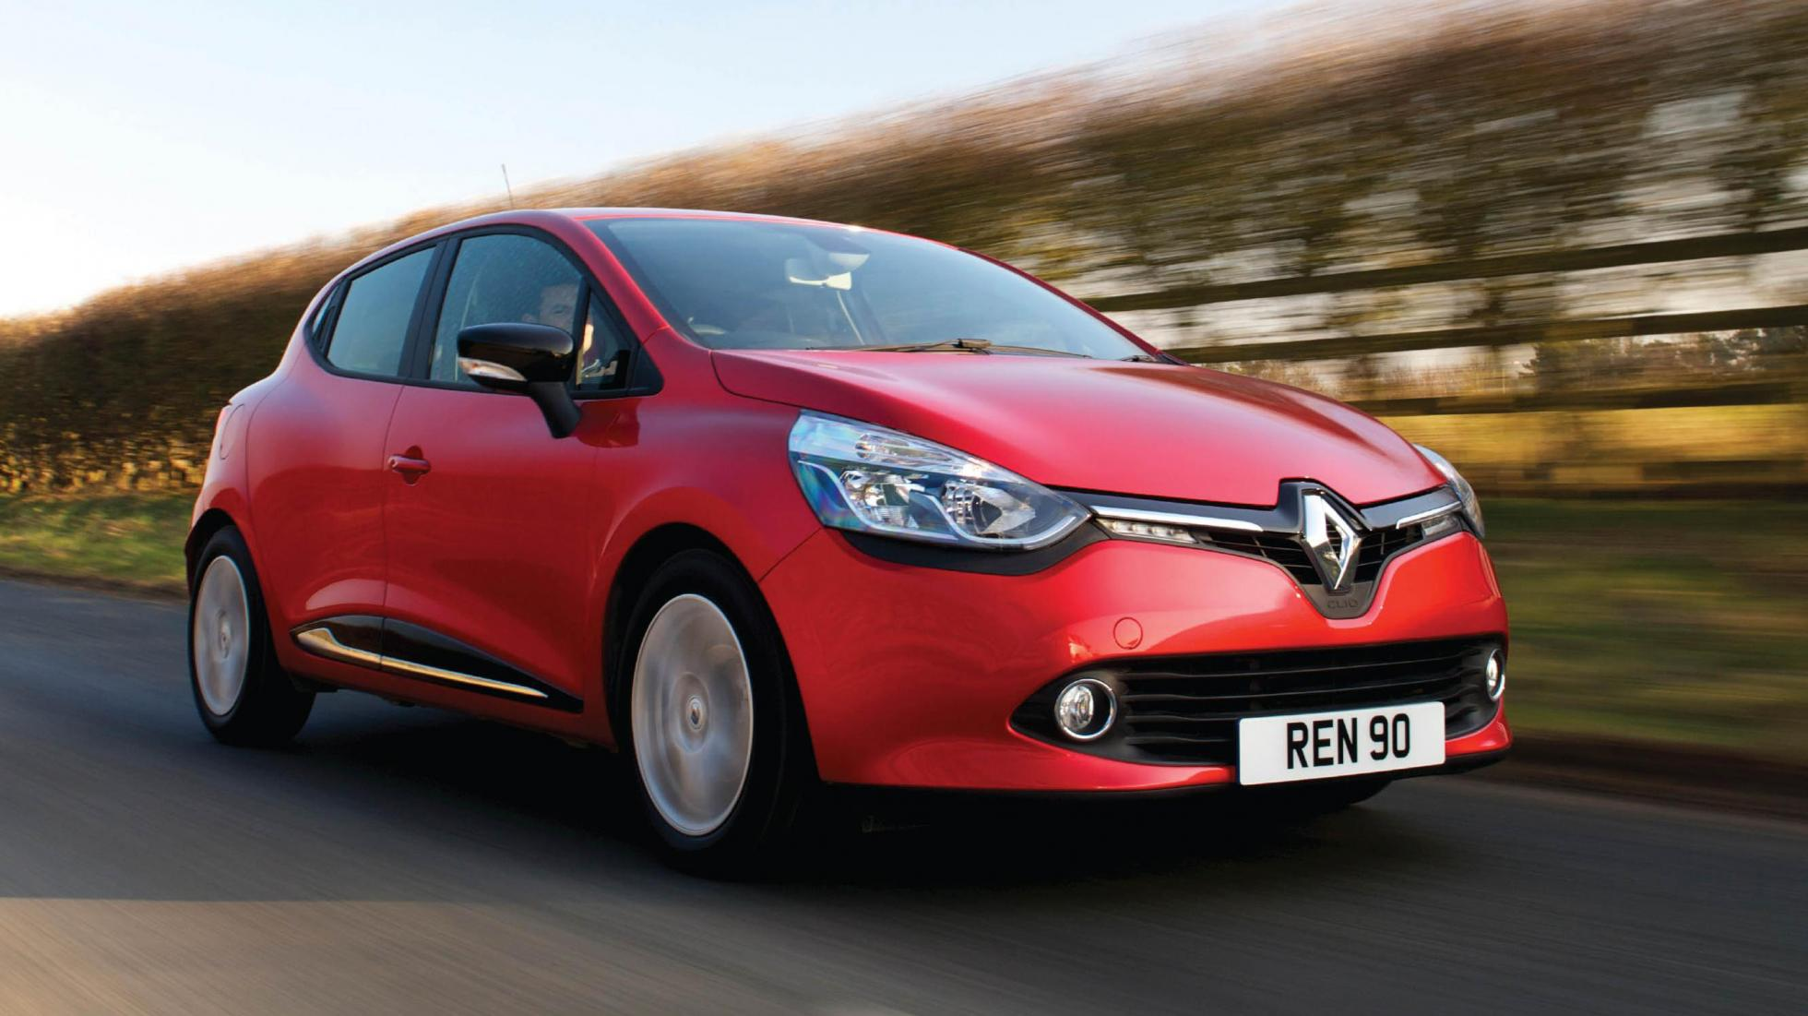
Electric cars too expensive?
Renault Zoe cost £25,000
Renault Clio cost £15,000
Electric 4p mile Petrol 13p mile
Total ownership cost reduces the more the vehicle is used

Slide 4
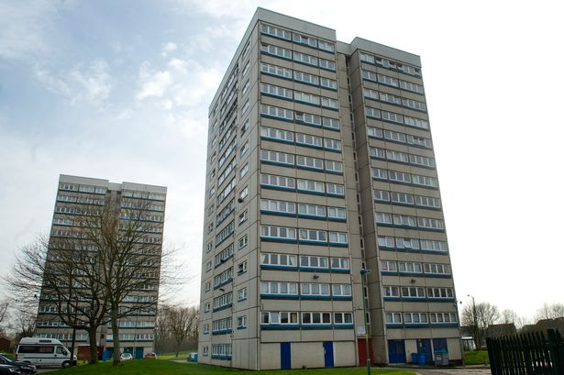
Challenge
Low income
Illegal levels of pollution
Old cars
Poor public transport
Notes:
Cash economy
No Membership costs
Doesn’t have to be linked to a bank account, this is more of an issue for the international sites than UK sites
Pay as you go
Security to access the vehicles
Real time state of charge
Cost per houe

Slide 5

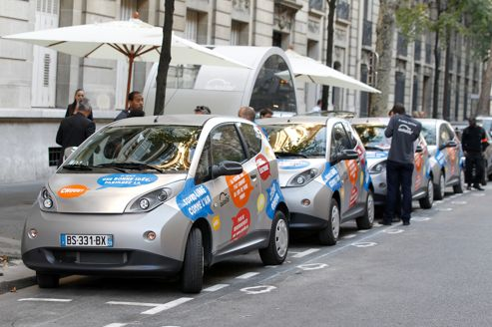
The opportunity
30% of the average European city is high density and low income.
45 million households high density and low income
30% penetration = 54,000 vehicles and annual revenue of €700 million
CO2 saving (well-to-wheel) of 150,000 tonnes and Air Quality improvements

Slide 6
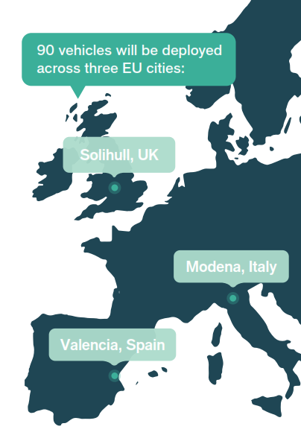
Project Overview
€1.8m EIT Climate KIC and
€2m private investment from ECar
3 year project
Proving investment model and communicating to investors and car share operators

Slide 7
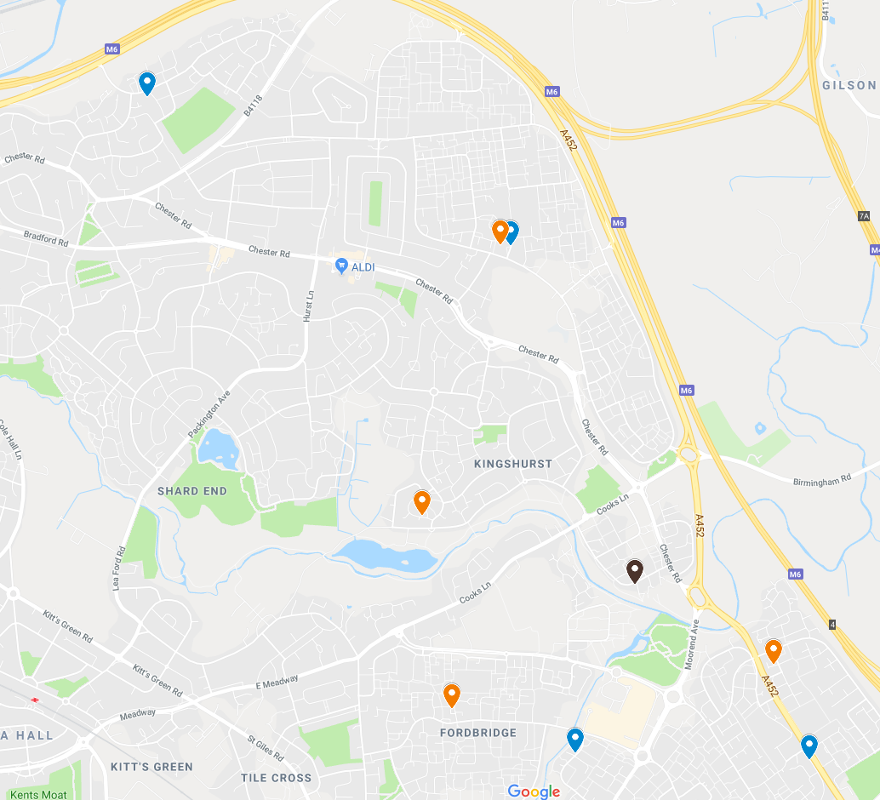
Birmingham
2-4 cars per hub
1,000 homes within 500m
10,000 driver without a car
V2G investment from UK Govt.
Challenges for project deployment

Slide 8
New Innovations
Pay as you go – impowering low income service users
Real time state of charge – confidence in vehicle range
Mobility as a Service - integration with public transport
V2G – delivering additional value when car not being driven

Slide 9

Thank you for listening
Charlotte Thiery Weetman
Programme Manager Electric Mobility
Charlotte.Thiery-weetman@cenex.co.uk

